Slide 1


Machine Learning Lab
https://mll.iiit.ac.in

Slide 2
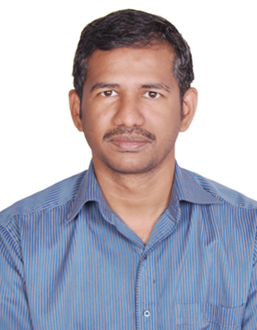
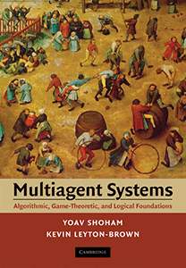
Praveen Paruchuri
Research Areas:
Applied AI/ML
Multi agent Systems Decision/Game Theory
Intelligent Transportation
…

Slide 3
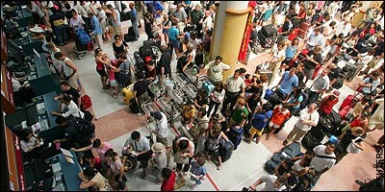
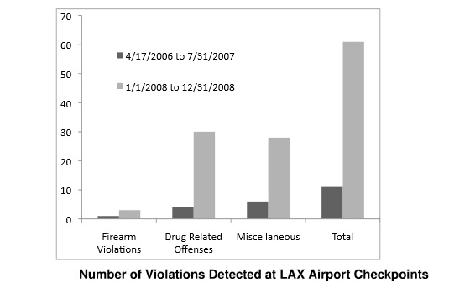
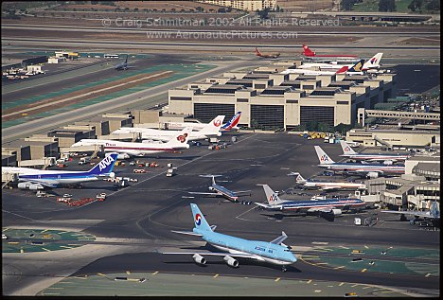
Improving Security using Game Theory
ARMOR: Assistant for Randomized Monitoring Over Routes
Deployed at the Los Angeles International Airport since Aug’07
Used for setting checkpoints and allocating canine units
AAMAS 2008

Slide 4
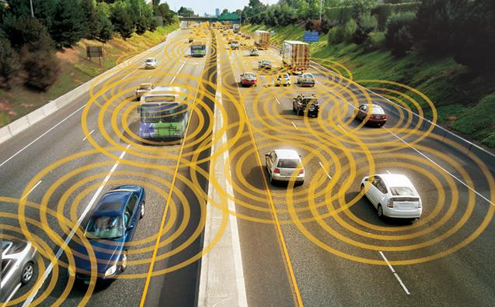
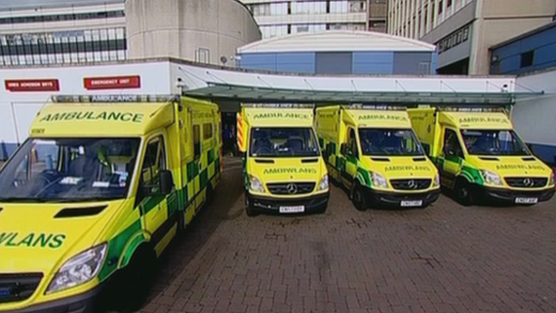
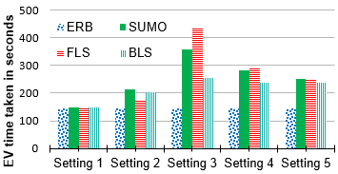
Analysis of Lane Level Dynamics
Slow moving traffic in heavily populated cities is a major issue
Recent advances in ITS can make things better (for ambulances)
We introduce BLS algorithm to optimize lane level dynamics
IEEE IV 2016

Slide 5
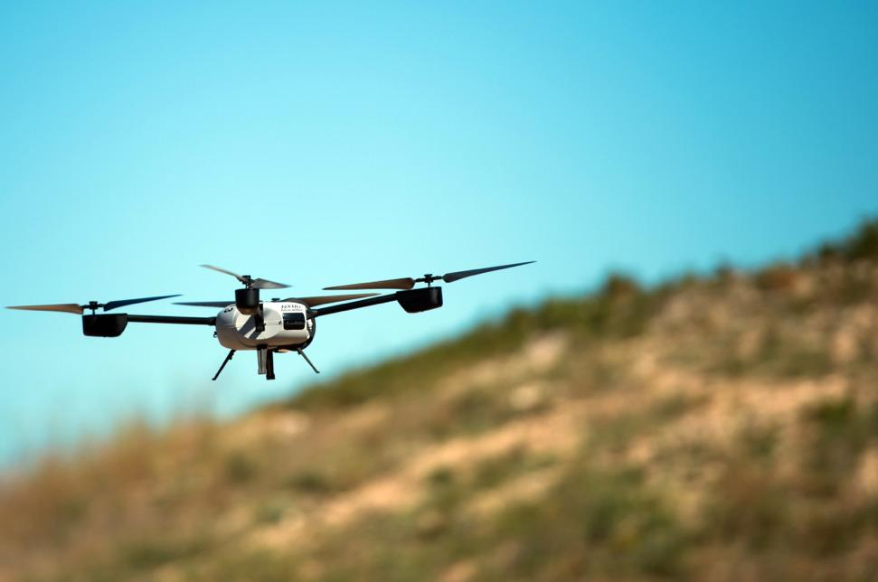
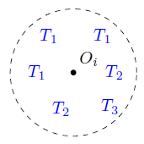
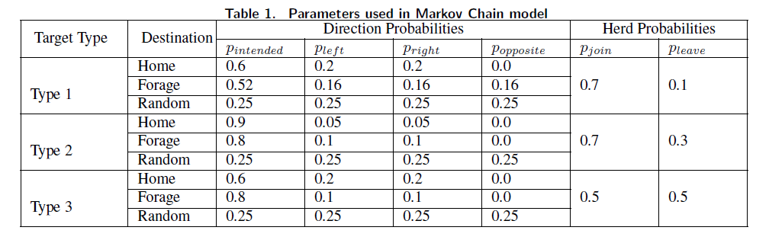
Improving Wildlife Monitoring
Wildlife population rapidly declining across the world
UAVs (and UGVs) to perform CTO (Cooperative Target Observation)
MCDA-CTO algorithm developed
Explore Reinforcement Learning
HICSS 2020

Slide 6
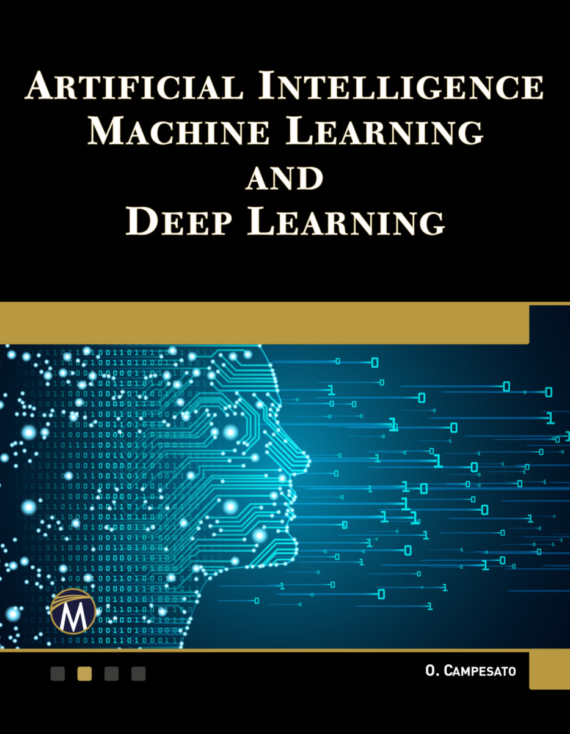
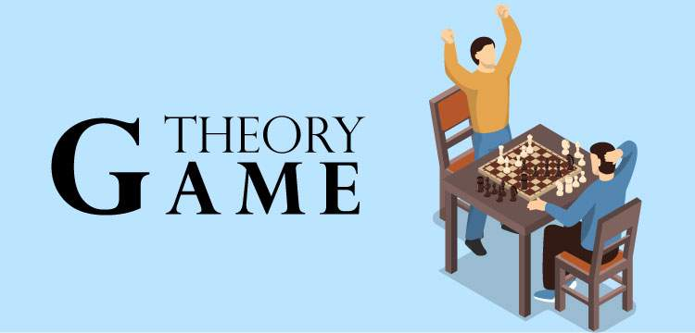
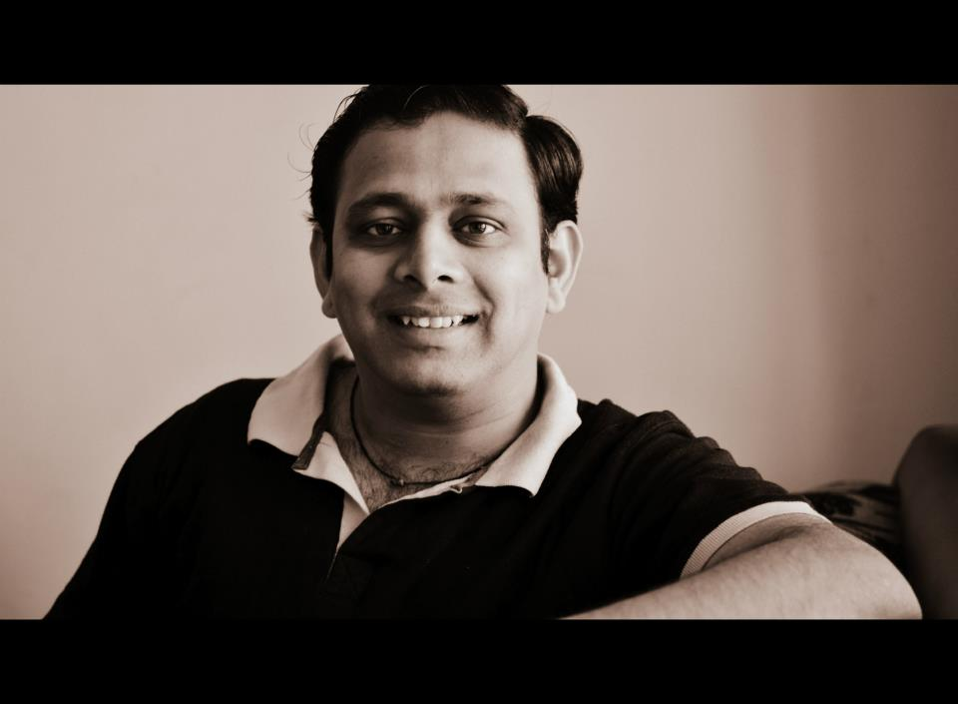

Sujit Gujar
Research Areas
MAGNETAR
(MAchine learning, Games, Network, Economics
Trust and Algorithmic Research)
Game Theory and Mechanism Design
Game Theory and Machine Learning
Distributing Trust and Blockchains
Fairness and Privacy in AI

Slide 7
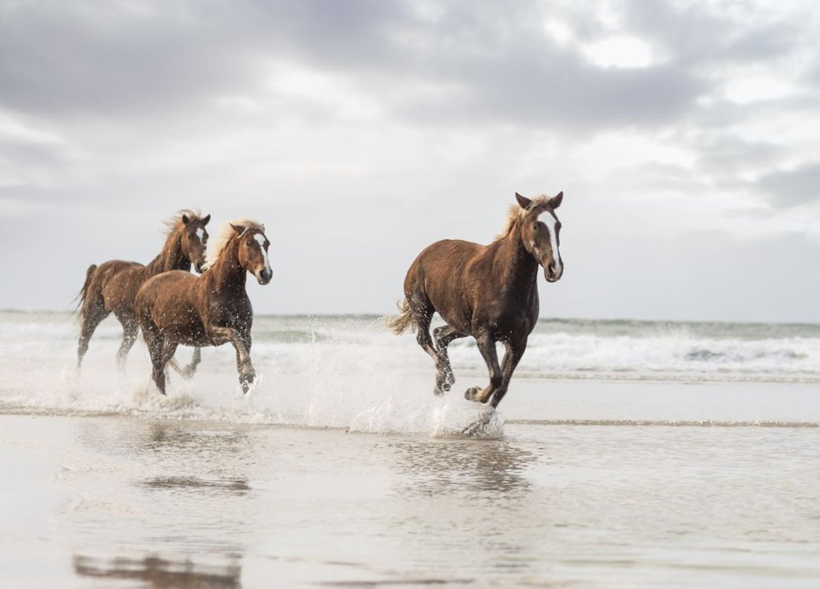
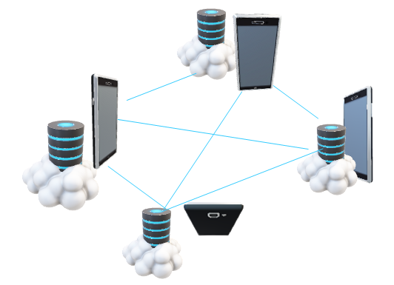
Building Next-Gen Blockchains
Mneme: Mobile DLT
INFOCOM 2020
IoT 2021
ASHWChain GTiB@WINE’20a
TiraMisu IEEE ICBC 2022
LocalCoin: Proof-of-Location based Blockchain
BitCoinF: Fair rewards in bitcoin
Fairness in blockchains
Faithfulness in blockchains
Useful PoW IEEE Blockchain'21
MobiHoc’16
AAMAS’20
AAMAS’21
GTiB@WINE’20b

Slide 8
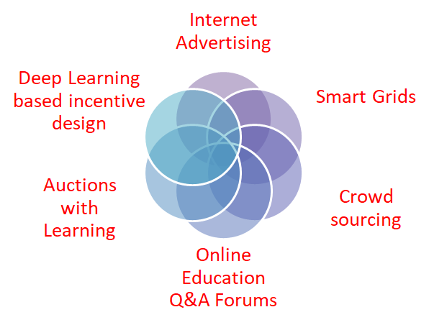
Machine Learning and Mechanism Design for Modern AI Web Applications
AAMAS 16b,20
AAMAS 18a,19a
AAAI 19,20a,20b
PRICAI'21 AAMAS'22a
AAMAS 16a,17,19b,20,
21b,22c
AAMAS 14,15, AAMAS 21a
AI 18, AMAI 19c, AAMAS'22b
AAMAS 18b,20 PRICAI 19

Slide 9
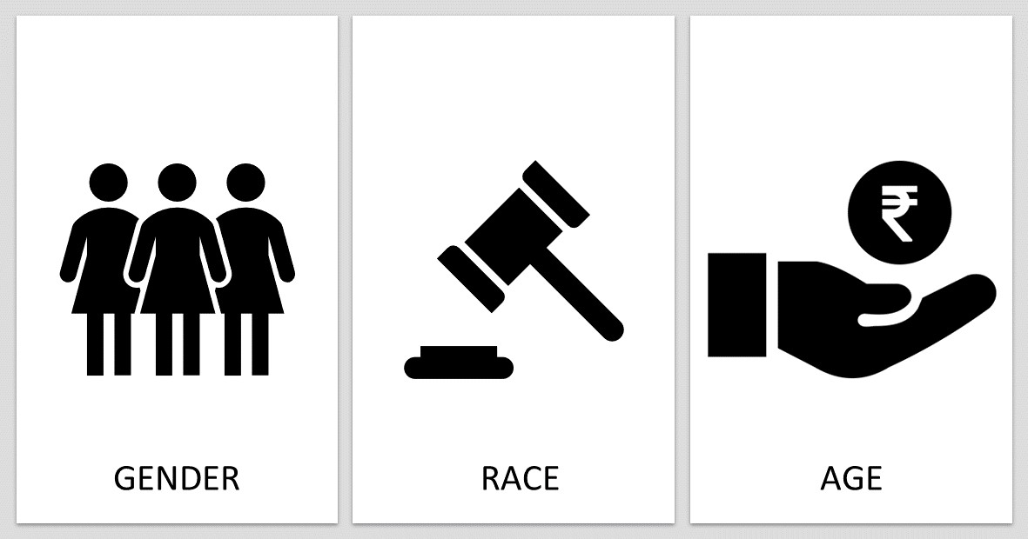
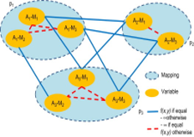
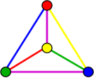
Fairness and Privacy in AI
Privacy Preserving in Multi-Agent optimization and Reinforcement Learning. E.g. Meeting Scheduling, Graph Coloring
Key Concept Differential Privacy
PPAI@AAAI 2021, ICONIP'21a, DAI'21, Wi-IAT'21c
AAAI'22, CODS-COMAD'22, ECMl-PKDD'22
Classification should not depend upon sensitive information such as gender, race, age etc.
Similar individuals should get similar treatment
IJCAI 2020, UAI'22

Slide 10
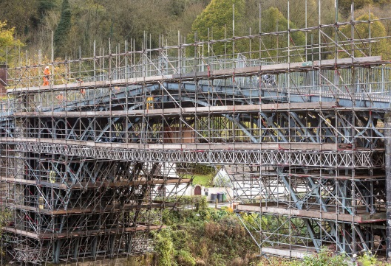

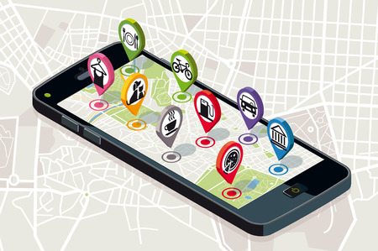
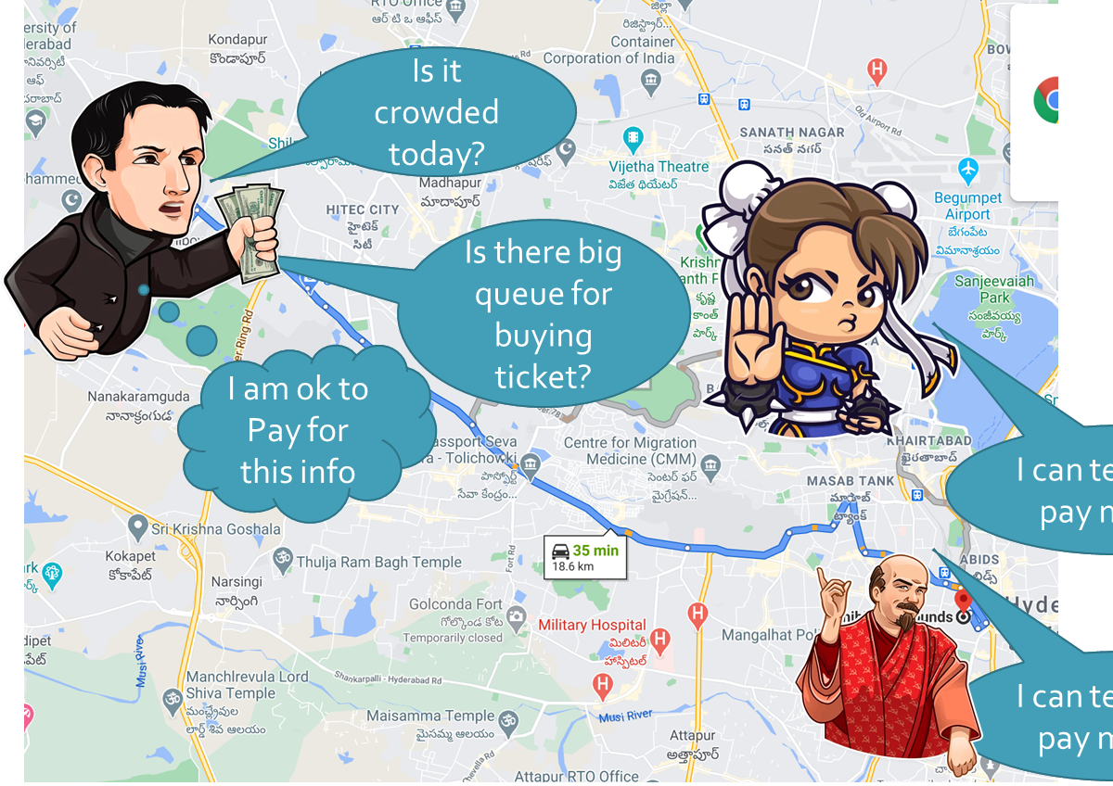
Information Aggregation over Internet (blockchains)
Applications
e-Governance (CryptoSwaraj)
Crowdfunding
Location Based Services
Crowdsourcing
ECAI 16, AAMAS 17,19, IJCAI 19
IJCAI 19, EMAS20, GAIW 20, PRICAI'21b, Wi-IAT'21a, WI-IAT'21b, GAIW'22,

Slide 11
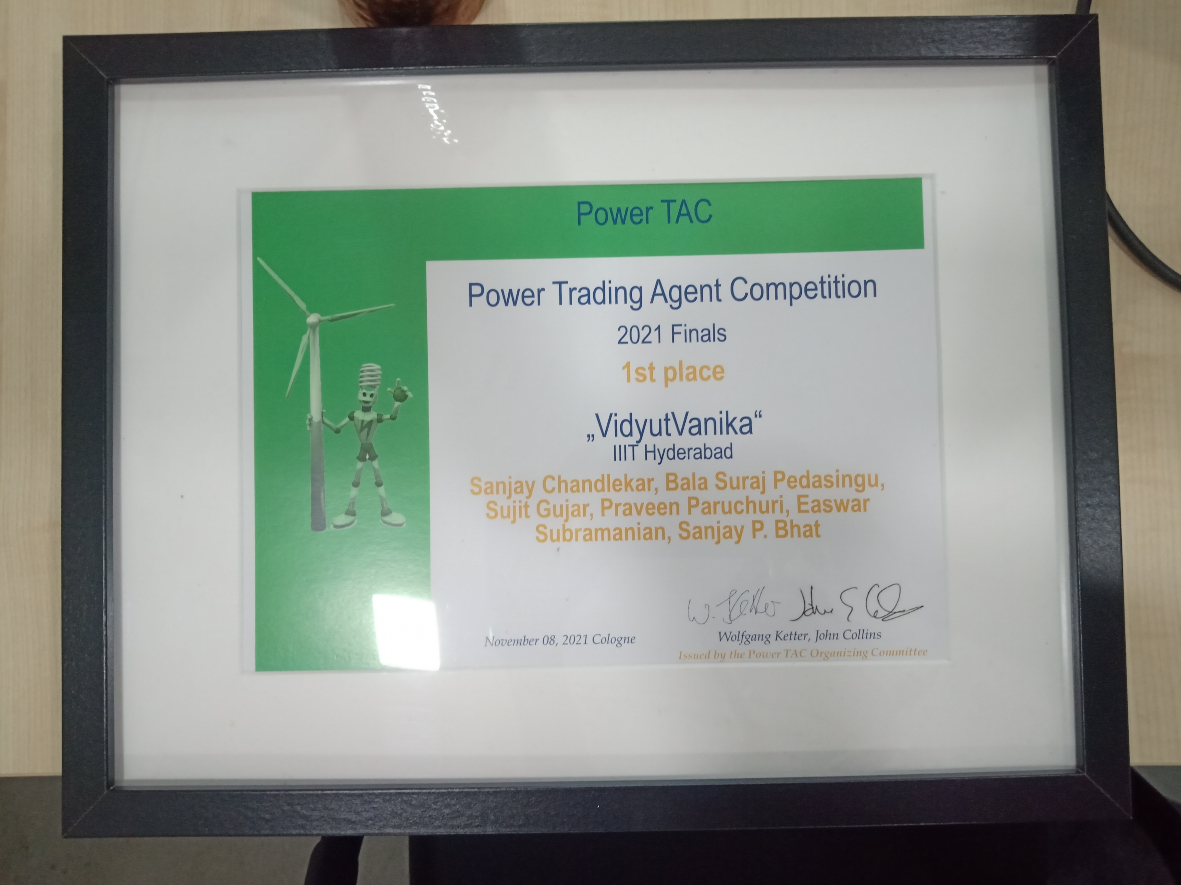
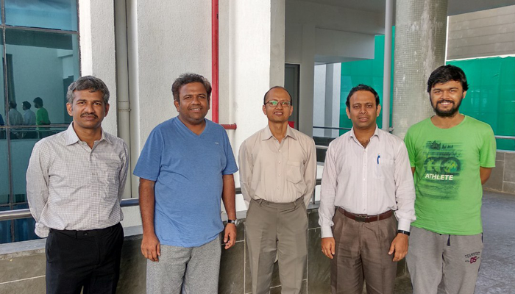
Team VidyutVanika [Placed 2nd in PowerTac 2018]
Team VidyutVanika [Placed 1st in PowerTac 2022]
IIIT-H Team: Sanjay Chandlekar, Dr. Sujit Gujar, Dr. Praveen Paruchuri
TCS Research Team: Bala Suraj Pedasinghu, Dr. Easwar Subramanian, Dr. Sanjay Bhat
IIIT-H Team: Susobhan Ghosh, Dr. Sujit Gujar, Dr. Praveen Paruchuri
TCS Research Team: Dr. Easwar Subramanian, Dr. Sanjay Bhat

Slide 12
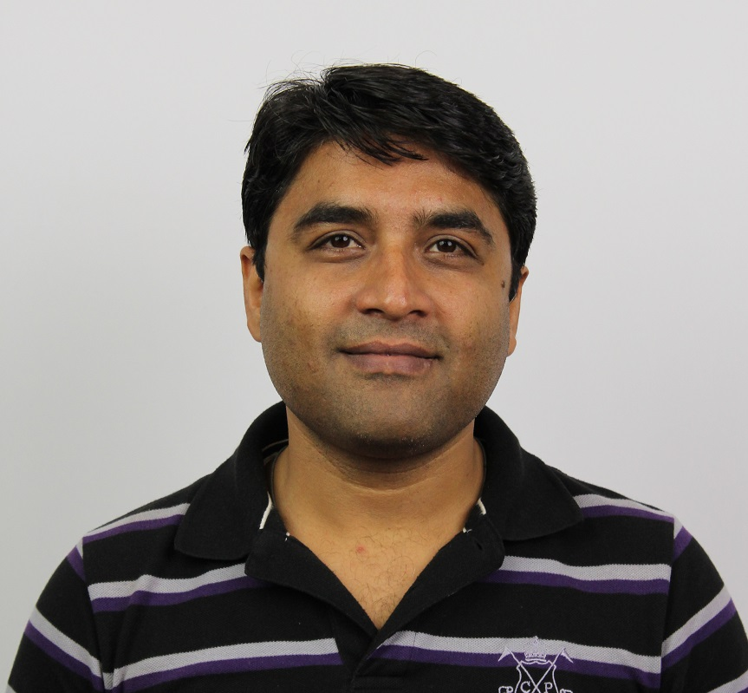
Naresh Manwani
Research Areas:
Robustness, Explainability, Fairness
Learning with incomplete supervision
Learning in high risk scenarios
Auto Exploratory Data Analysis

Slide 13
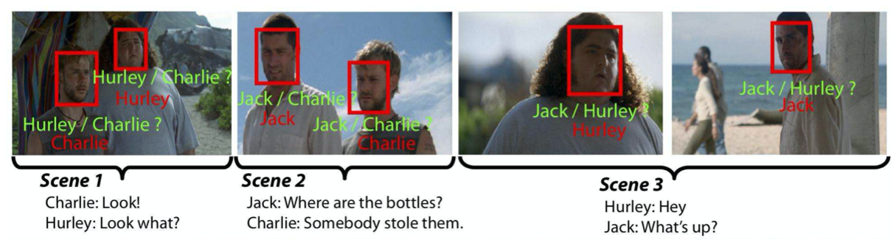
Learning under incomplete supervision
Applications:
Recommendation systems
Image/Video Tagging
CoDS-COMAD 2019, PAKDD 2020, IEEE NNLS 2020, ACML 2020, CoDS-COMAD 2021, PAKDD 2022

Slide 14
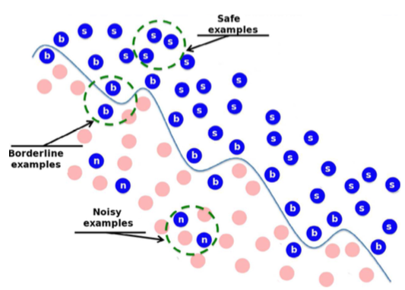
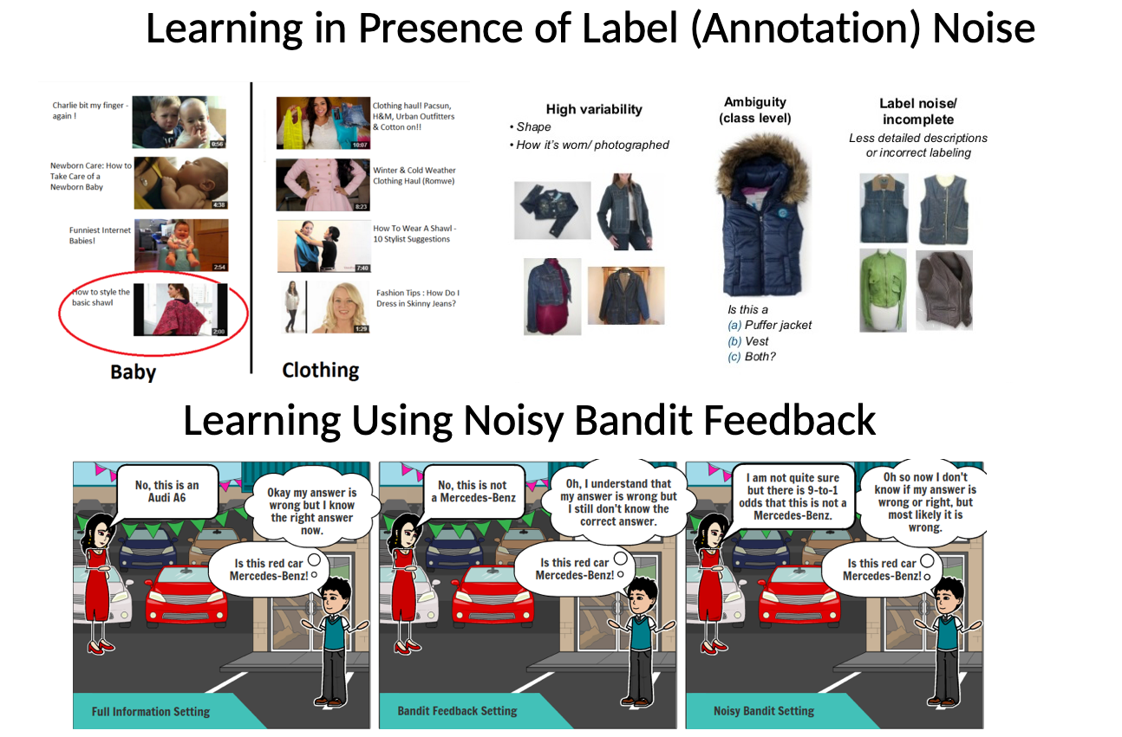
Robust Machine Learning
Robustness against
Label Noise
Noisy Bandit Feedbacks
Neurocomputing 2015, PAKDD 2017, CoDS-COMAD 2020, ACML 2020, PAKDD 2021, ICAART 2022

Slide 15

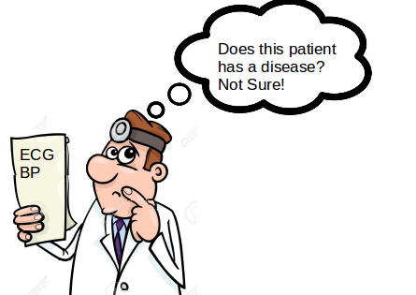
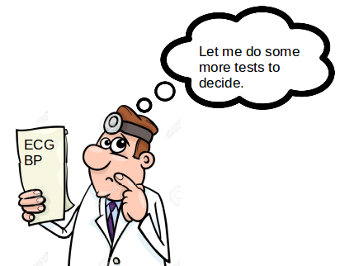
Efficient Learning in High Risk Situations
Cost of wrong prediction is very high. Applications:
Healthcare
Finance
Crowdsourcing
PAKDD 2015, AAAI 2019, AAAI 2020, UAI 2021

Slide 16
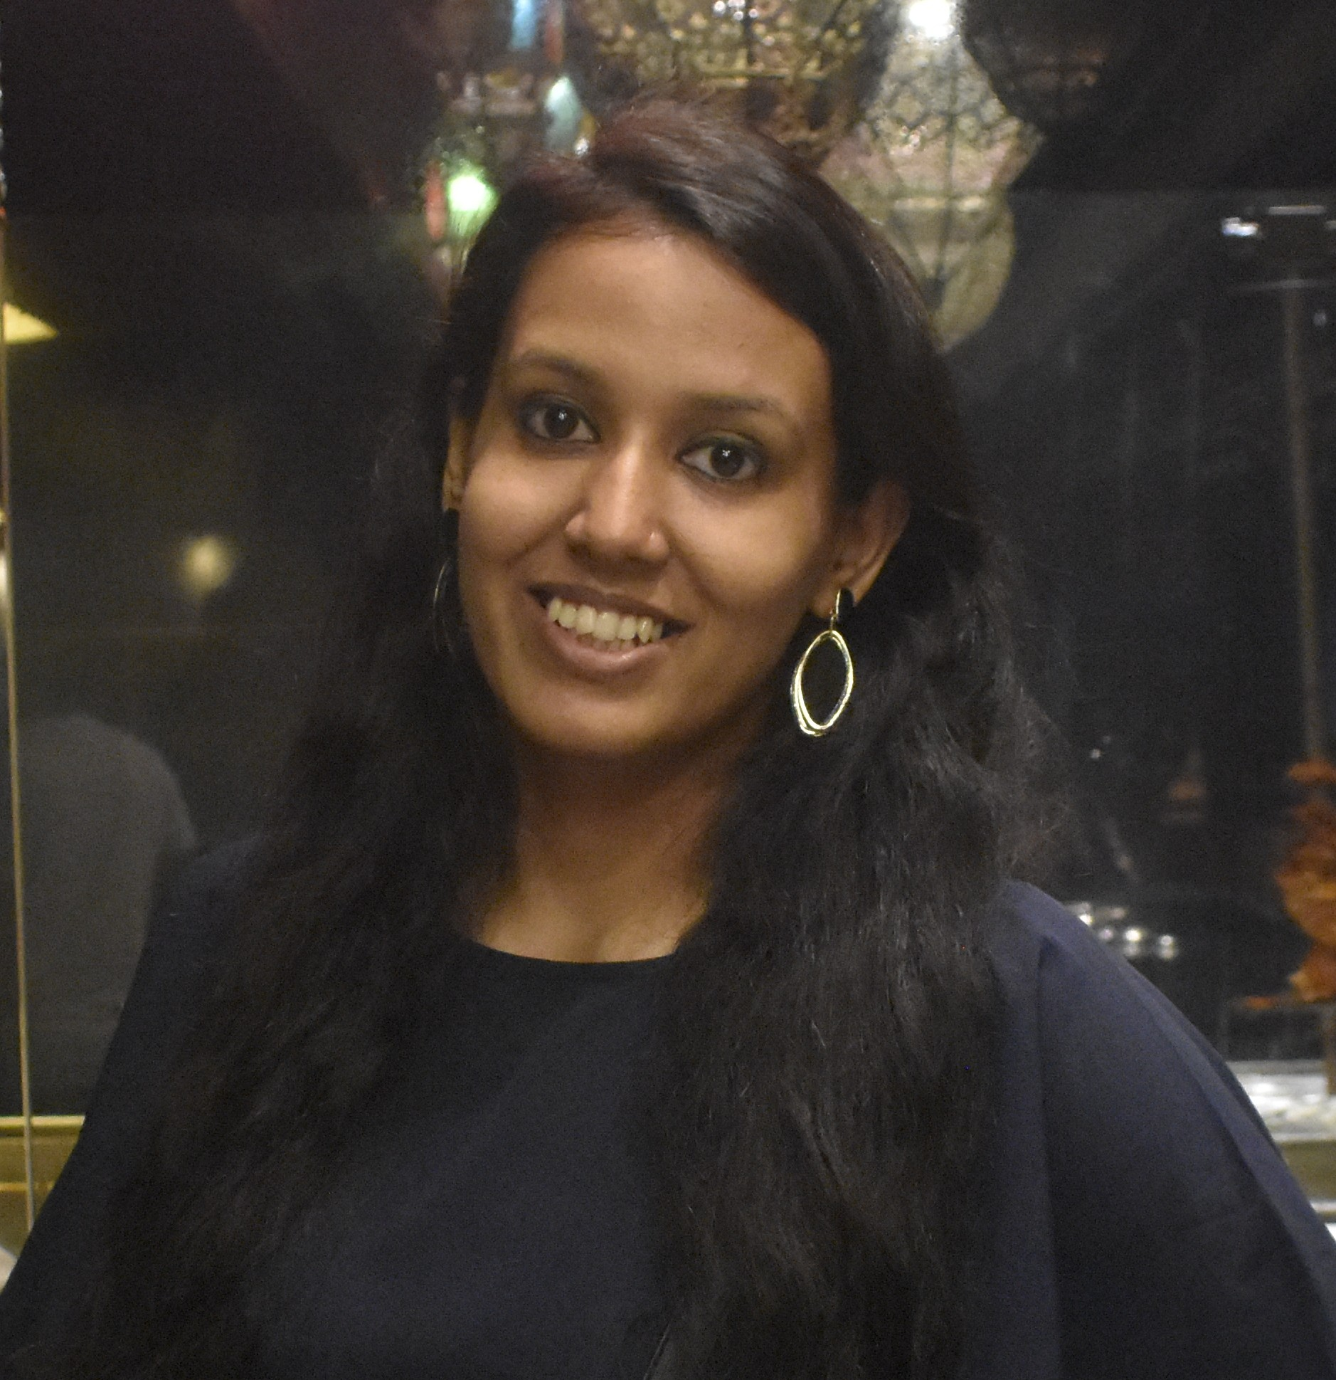
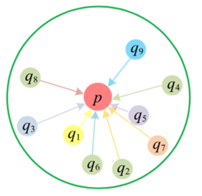
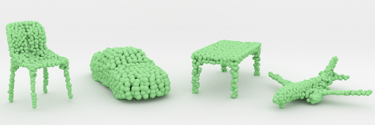
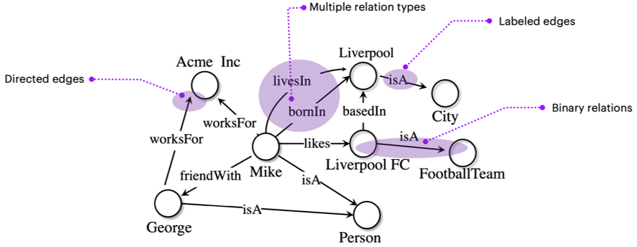
Charu Sharma
Research Interests
Geometric Deep Learning for graphs and 3D data (3D vision)
Graph NNs, Knowledge Graphs
Self-Supervised, Few-Shot Learning
Optimal Transport, Topological Data Analysis

Slide 17
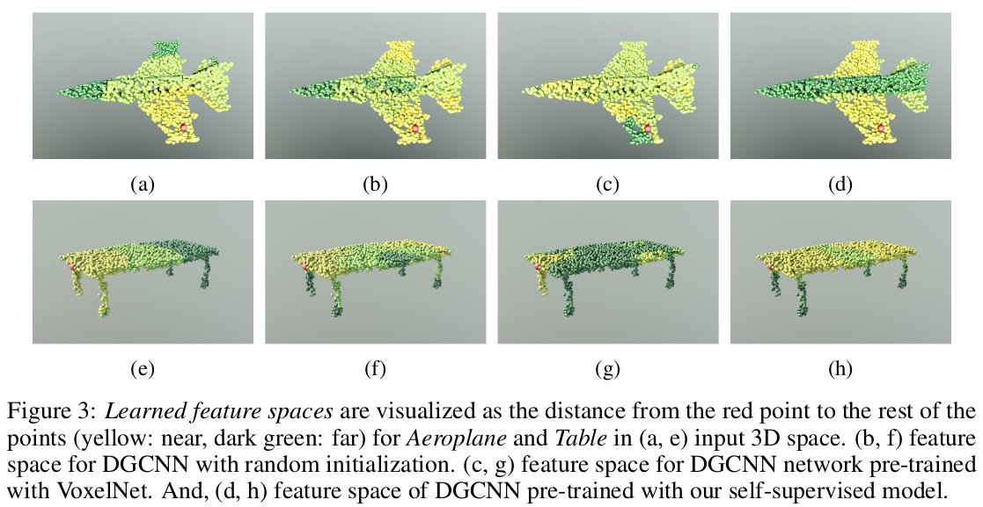
Self-Supervised 3D Point Cloud Representation Learning
Working with non- Euclidean domain comes with a unique set of research challenges.
Learning qualitative representations require large-scale and densely-annotated data samples.
Geometry plays major role.
Prototypical and transfer learning solve some of the challenges

Slide 18
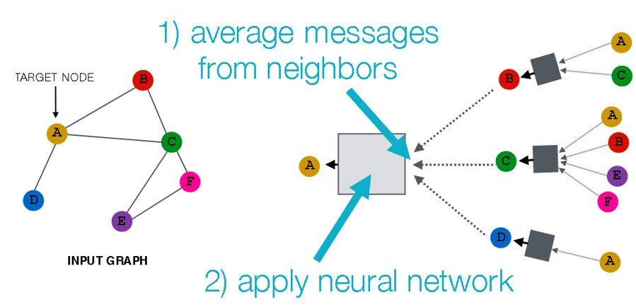
Graph Neural Networks
What is the underlying structure?
Geometry plays major role.
GNNs suffer from scalability issues.
Compression is the way to go. Make use of transferable features for distillation without losing any structural information.

Slide 19
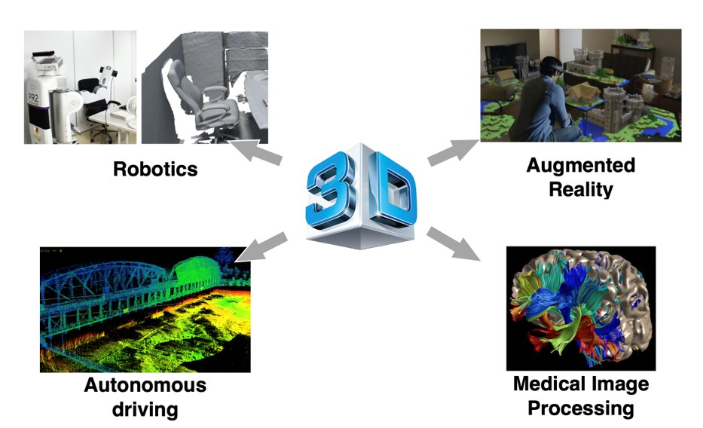
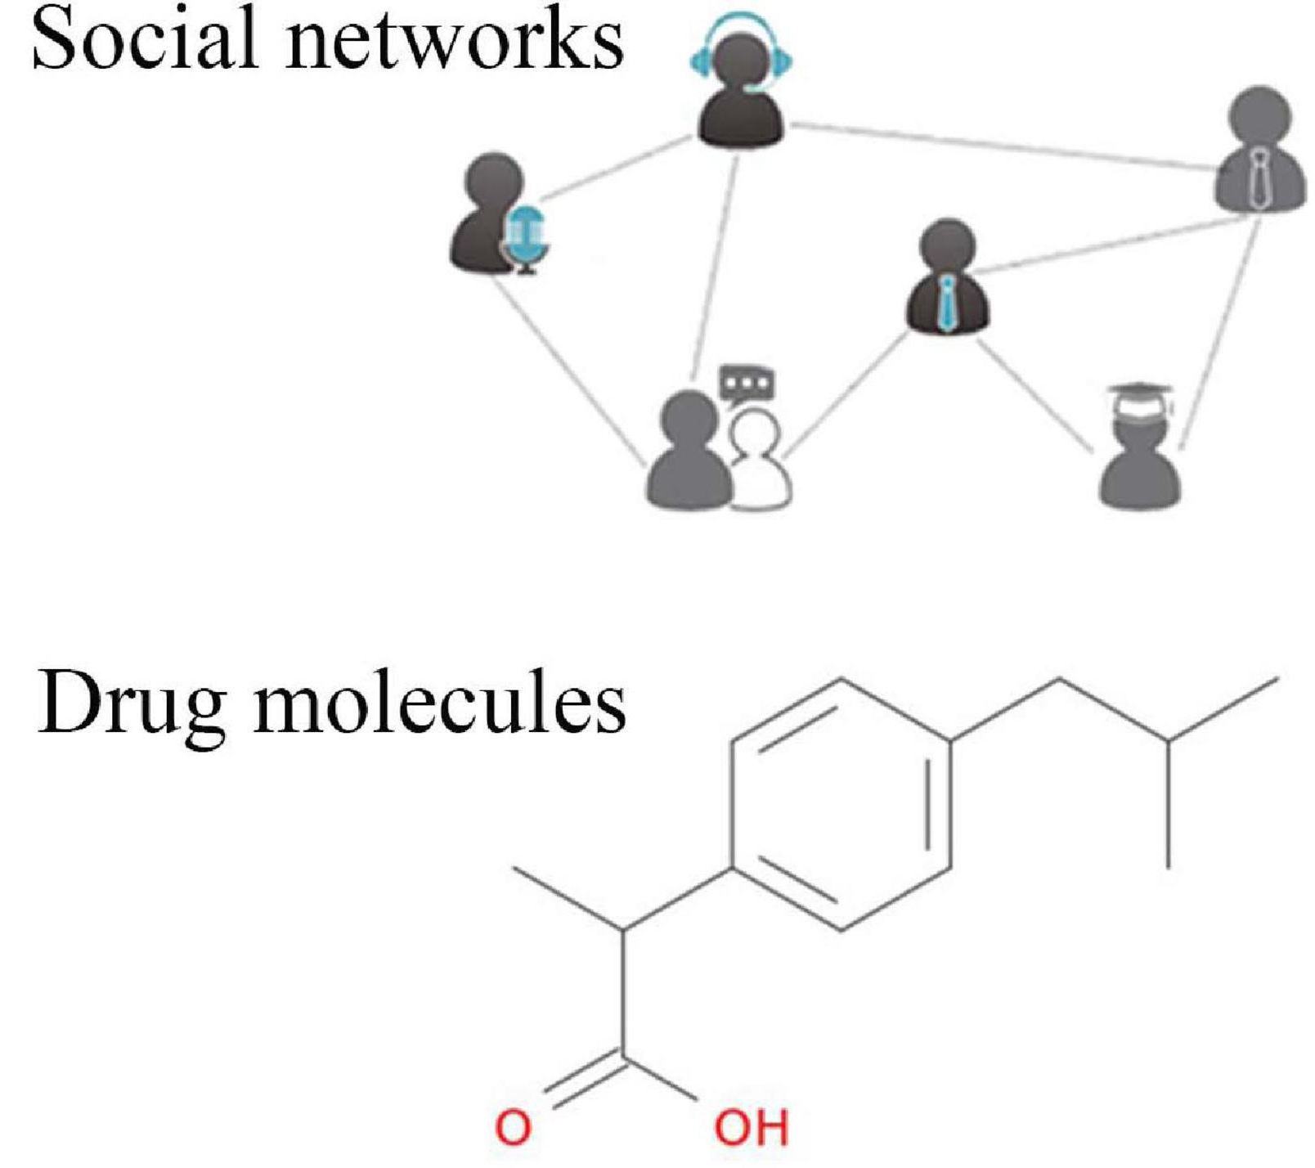
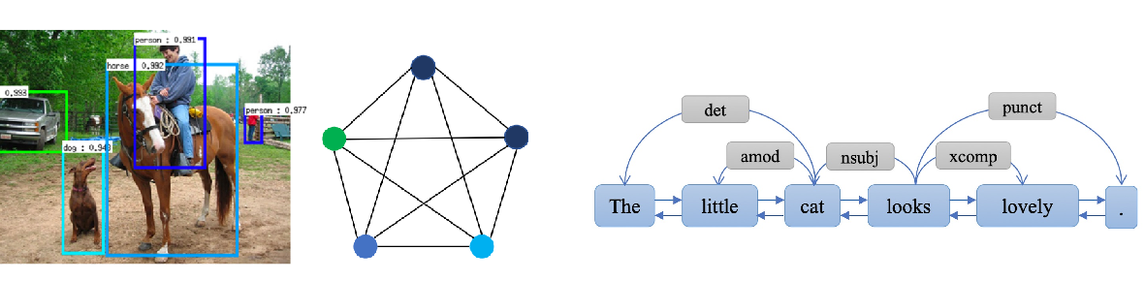
Applications

Slide 20
Publications
Anmol Goel, Charu Sharma, and Ponnurangam Kumaraguru. "An Unsupervised, Geometric and Syntax-aware Quantification of Polysemy." Conference on Empirical Methods and Natural Language Processing (EMNLP), 2022.
Charu Sharma, and Manohar Kaul. "Self-Supervised Few-Shot Learning on Point Clouds." Advances in Neural Information Processing Systems (NeurIPS), 2020.
Charu Sharma, and Manohar Kaul. "Simplicial Complex based Point Correspondence between Images warped onto Manifolds." In European Conference on Computer Vision (ECCV), 2020.
Charu Sharma, Jatin Chauhan and Manohar Kaul, "Learning Representations using Spectral-Biased Random Walks on Graphs," 2020 International Joint Conference on Neural Networks (IJCNN), 2020.
Deepak Nathani*, Jatin Chauhan*, Charu Sharma*, and Manohar Kaul. "Learning Attention-based Embeddings for Relation Prediction in Knowledge Graphs." Association for Computational Linguistics (ACL), 2019. (*- equal contribution)
Charu Sharma, Deepak Nathani, and Manohar Kaul. "Solving partial assignment problems using random clique complexes." In International Conference on Machine Learning (ICML), 2018.

Slide 21
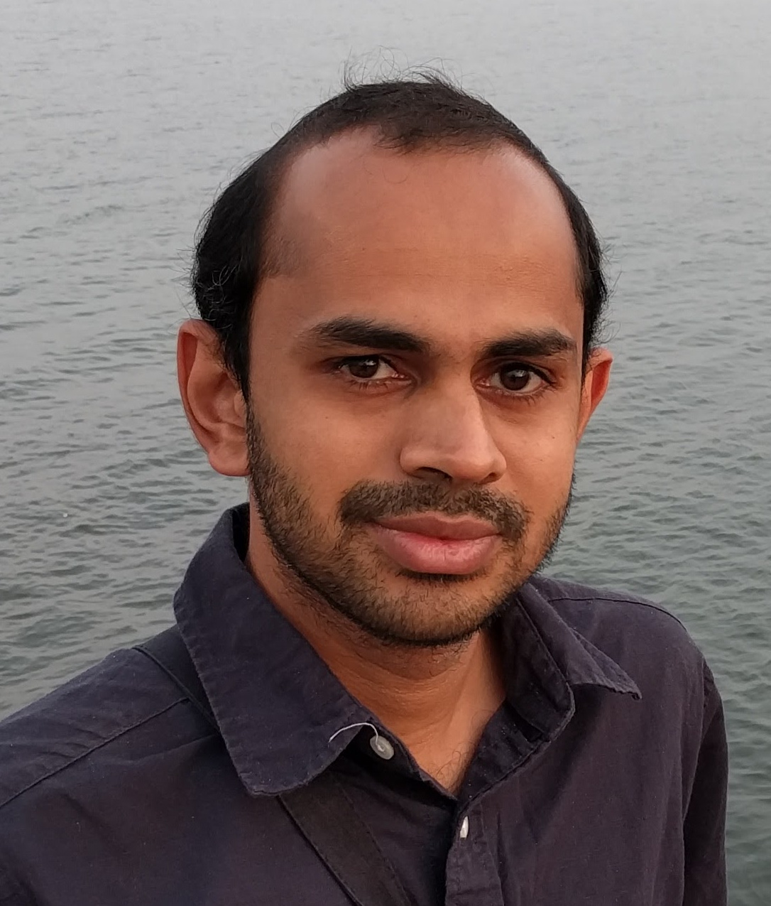
Girish Varma
(CSTAR, Affiliate with MLL)
Research Interests
- Computer Vision:
- Generative Modeling: Improving Normalizing Flows.
- Realtime Segmentation and Img <-> Img problems.
- Theoretical CS & ML:
More details at: https://girishvarma.in/

